Slide 1

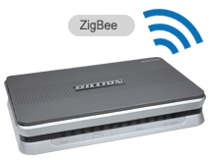
www.studymafia.org
Seminar
On
ZIGBEE TECHNOLOGY
Submitted To: Submitted By:
www.studymafia.org www.studymafia.org
Notes:
1

Slide 2
Content
Introduction
History
Device Types
Zigbee Home Automation Example
How Zigbee Works
Why does Zigbee Do
Layer of Zigbee Networks
Topologies
Uses
Future
Conclusion

Slide 3

Introduction
Technological Standard Created for Control and Sensor Networks
Based on the IEEE 802.15.4 Standard
High level Communication
Wireless Personal Area Networks (WPANs)
Created by the ZigBee Alliance

Slide 4
History
ZigBee-style networks began to be conceived about 1998, when many engineers realized that both WiFi and Bluetooth were going to be unsuitable for many applications.
In particular, many engineers saw a need for self-organizing ad-hoc digital radio networks.
The IEEE 802.15.4 standard was completed in May 2003.
The ZigBee specifications were ratified on 14 December 2004.
The ZigBee Alliance announces public availability of Specification 1.0 on 13 June 2005.

Slide 5
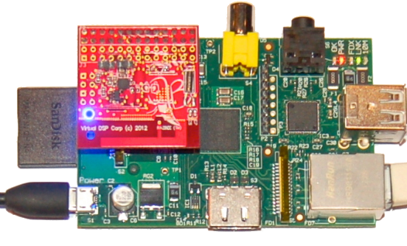
Device types
There are three different types of ZigBee device:
ZigBee coordinator (ZC)
ZigBee Router (ZR)
ZigBee End Device (ZED)

Slide 6
Types Explained…
ZigBee coordinator (ZC): The most capable device, the coordinator forms the root of the network tree and might bridge to other networks.
There is exactly one ZigBee coordinator in each network. It is able to store information about the network, including acting as the repository for security keys.

Slide 7
Types Explained…
ZigBee Router (ZR): Routers can act as an intermediate router, passing data from other devices.
ZigBee End Device (ZED): Contains just enough functionality to talk to its parent node (either the coordinator or a router); it cannot relay data from other devices. It requires the least amount of memory, and therefore can be less expensive to manufacture than a ZR or ZC.

Slide 8
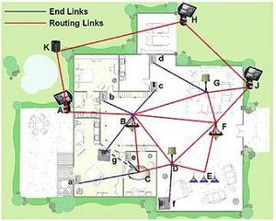
ZigBee Home Automation Example

Slide 9
Why does Zigbee Do
Operates in Personal Area Networks (PAN?s) and device-to-
device networks
Connectivity between small packet devices
Control of lights, switches, thermostats, appliances, etc.
Designed for wireless controls and sensors

Slide 10
How Zigbee Works
Topology
Star
Cluster Tree
Mesh
Network coordinator, routers, end devices

Slide 11
Layers of zigbee network:
Network and Application Support layer
Physical (PHY) layer
Media access control (MAC) layer

Slide 12
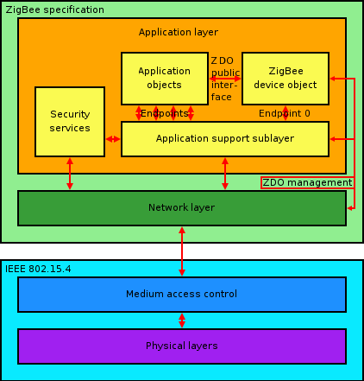
Zigbee Protocol Stack

Slide 13
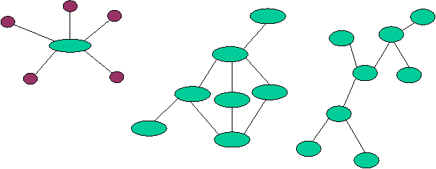
Topologies
Different topologies as illustrated below: star, peer-to-peer, mesh

Slide 14
Uses
In all of its uses, zigbee offers four inherent, beneficial characteristics:
Low cost:
Range and obstruction issue avoidance:
Multisource products:
Low power consumption:

Slide 15
Future of ZigBee:
A recent analyst report issued by West Technology Research Solutions estimates that by the year 2008, "annual shipments for ZigBee chipsets into the home automation segment alone will exceed 339 million units," and will show up in "light switches, fire and smoke detectors, thermostats, appliances in the kitchen, video and audio remote controls, landscaping, and security systems."
Futurists are sure to hold ZigBee up and say, "See, I told you so".

Slide 16
Conclusion
ZigBee is one of the global standards of communication protocol formulated by the relevant task force.
ZigBee is the newest and provides specifications for devices that have low data rates, consume very low power and are thus characterized by long battery life.

Slide 17
Referance
www.wikipedia.com
www.studymafia.org
www.google.com
www.zigbee.com

Slide 18
THANKS..!!!

